Slide 1

Te Pūtahi Ladies Mile Variation Overview

Slide 2
Location

Slide 3
Current Zoning

Slide 4
Planning Context
Indications from the Proposed District Plan Independent Hearings Panel
The WBLUS (2017) identified that additional urban scale development was appropriate at TPLM, noting it had high capability to absorb additional development, and to achieve urban development, recommended the inclusion of a “Ladies Mile Gateway Precinct”, anticipating low to medium density housing with a 75m setback from State Highway 6. It recommended a structure plan process to assess amenity, landscape and infrastructure issues.
The Council deliberately chose, at that time, not to move forward with the recommendations of WBLUS as it was then anticipated that the area would likely be subject to future SHA applications under the HAASHA, and an indicative master planning exercise had been undertaken as part of “Lead Policy”.

Slide 5
Planning Context
The Housing Accord’s Lead Policy (2017)

Slide 6
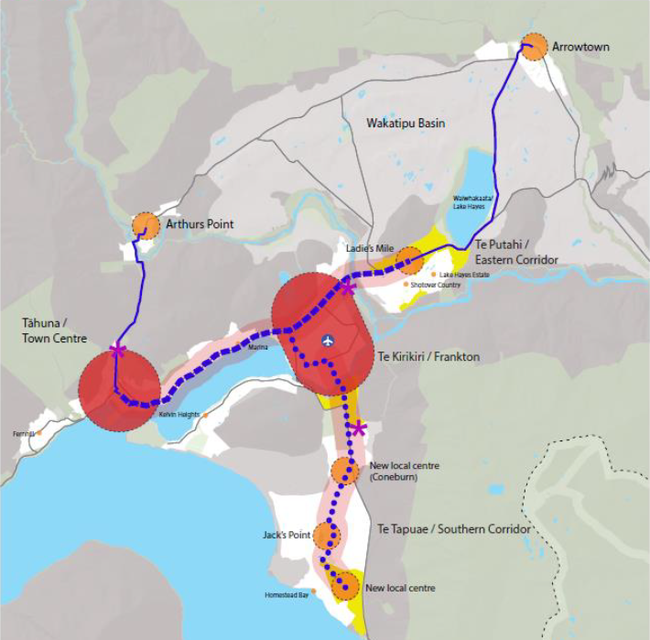
Planning Context
The Queenstown Lakes Spatial Plan | Grow Well Whaiora

Slide 7
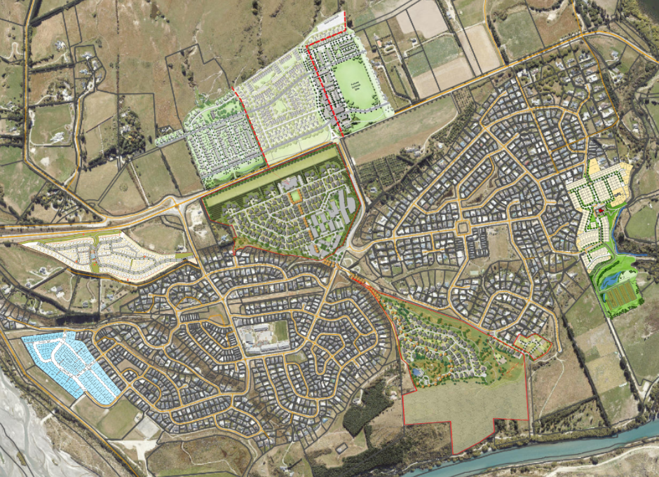
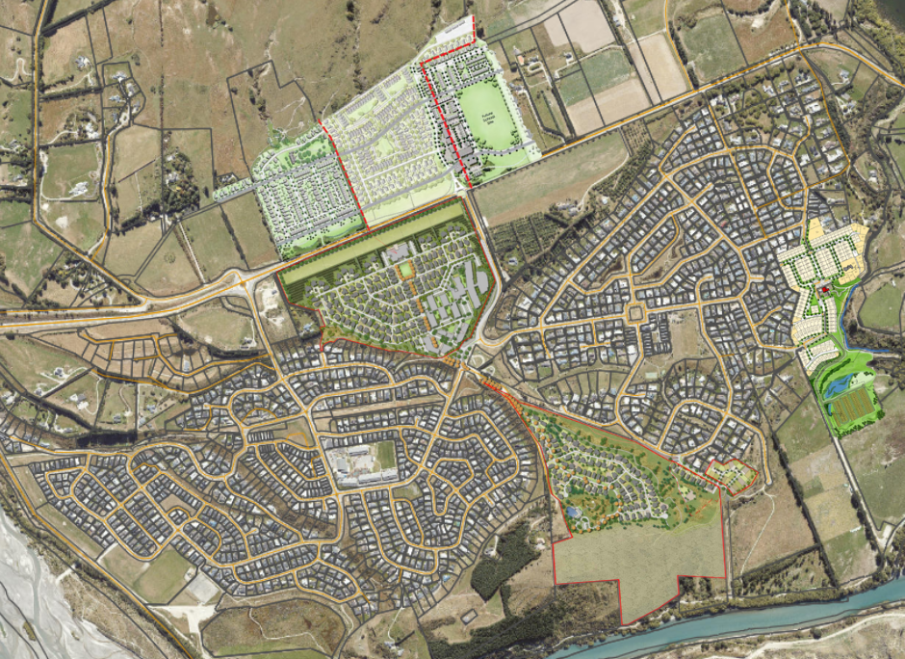
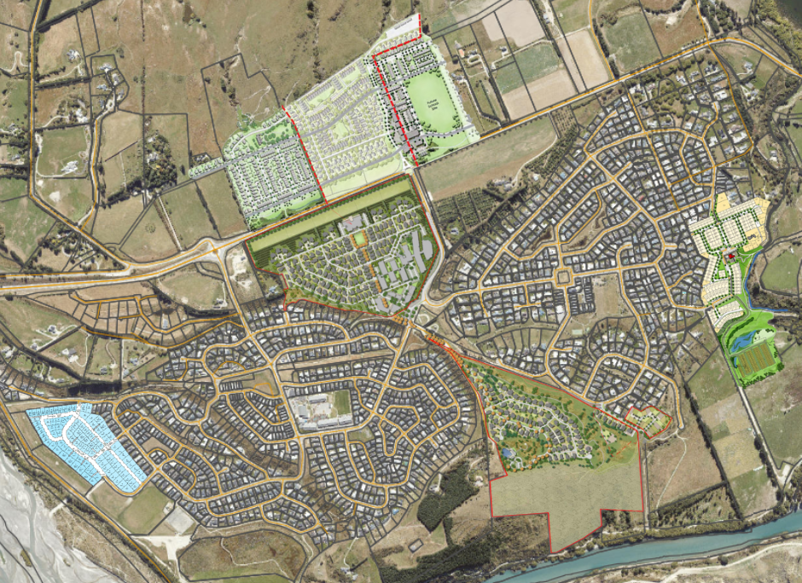
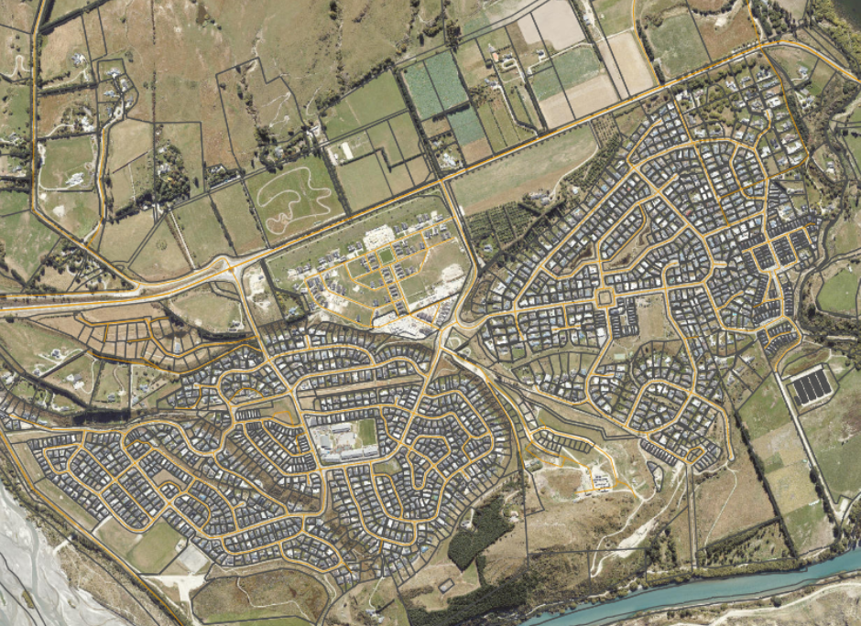
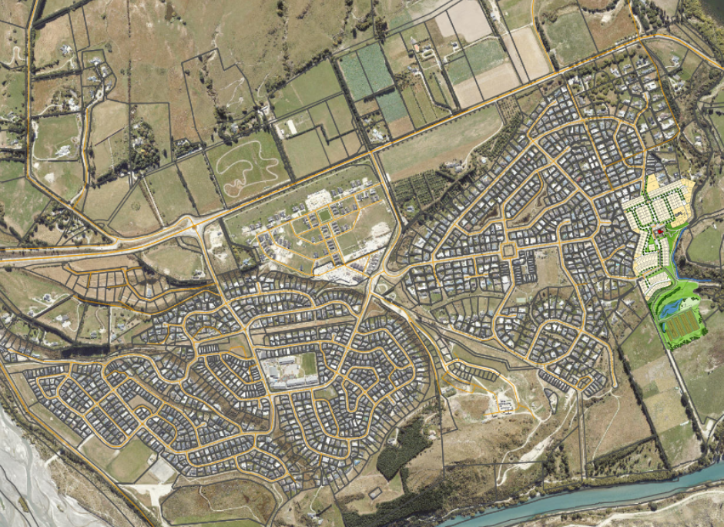
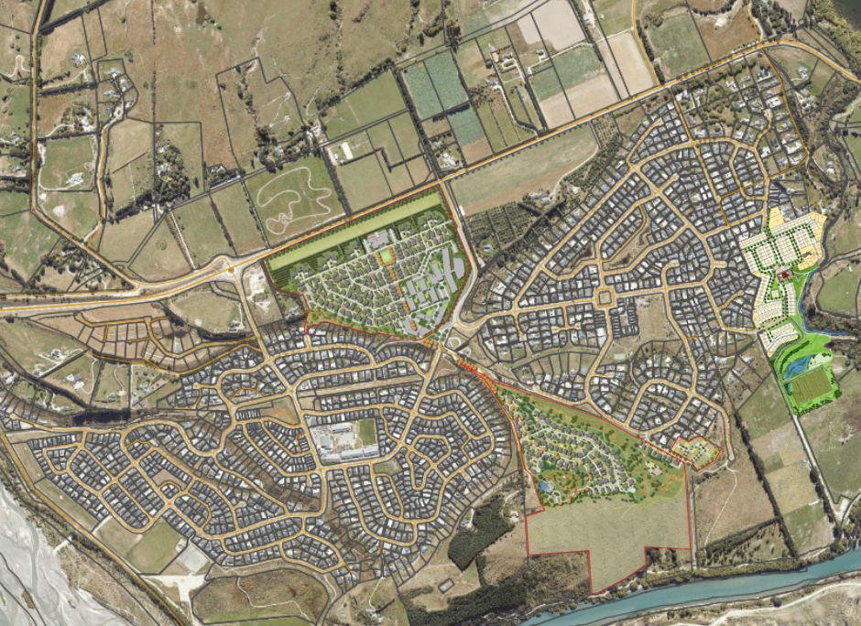
Planning Context
Special Housing Areas
Bridesdale
Queenstown Country Club
Glenpanel and Flint’s Park
Shotover Country
Laurel Hills

Slide 8
Planning Context
TPLM Masterplan Process and Plan Variation
Culmination of a series of moves, over the last 5+ years, towards masterplanning for the comprehensive, integrated urban development of the TPLM area.
TPLM Variation is the principal vehicle for implementation of the Spatial Plan’s intent for a new greenfields urban area within the Eastern Corridor.
Intention is for TPLM Variation to complement the existing suburban communities and for the Eastern Corridor as a whole to become a well-functioning urban environment.

Slide 9
TPLM Variation
Key Issues
Integration
Housing – diversity, affordability, efficiency
Non-residential activities
Traffic
Stormwater and ecology
Urban design and the built environment
Climate change and sustainable development

Slide 10
TPLM Variation
Key issue 1
Integration
Objective / policy framework:
Objective 49.2.1 Objective – Development complements and integrates with adjoining urban development at Te Pūtahi Ladies Mile and development south of State Highway 6.
Policy:
development to be consistent with the Structure Plan;
integration and co-ordination of location of activities, primary roading, key intersections, open spaces, green networks, and walkway / cycleway routes.
Methods:
Zoning Plan
Structure Plan

Slide 11
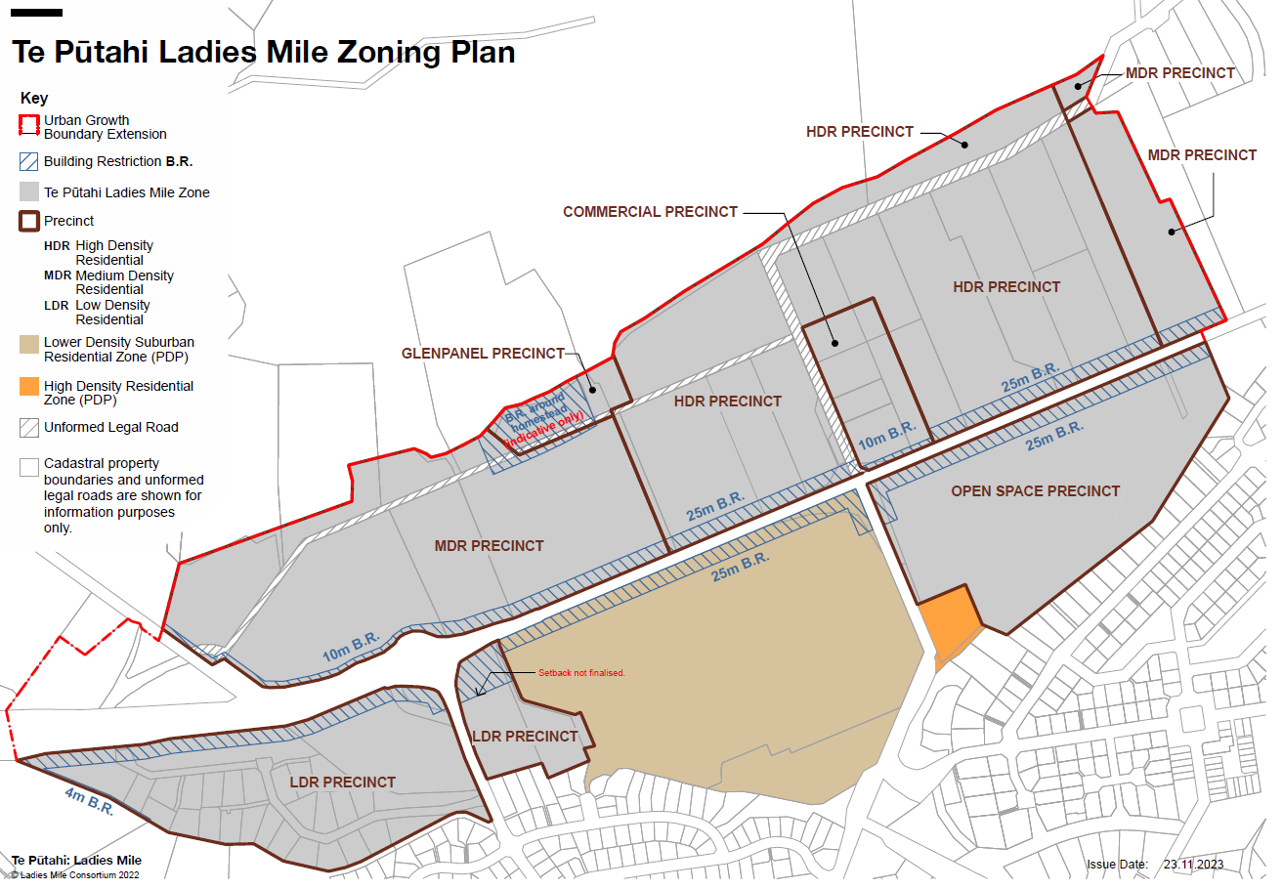
TPLM Variation

Slide 12
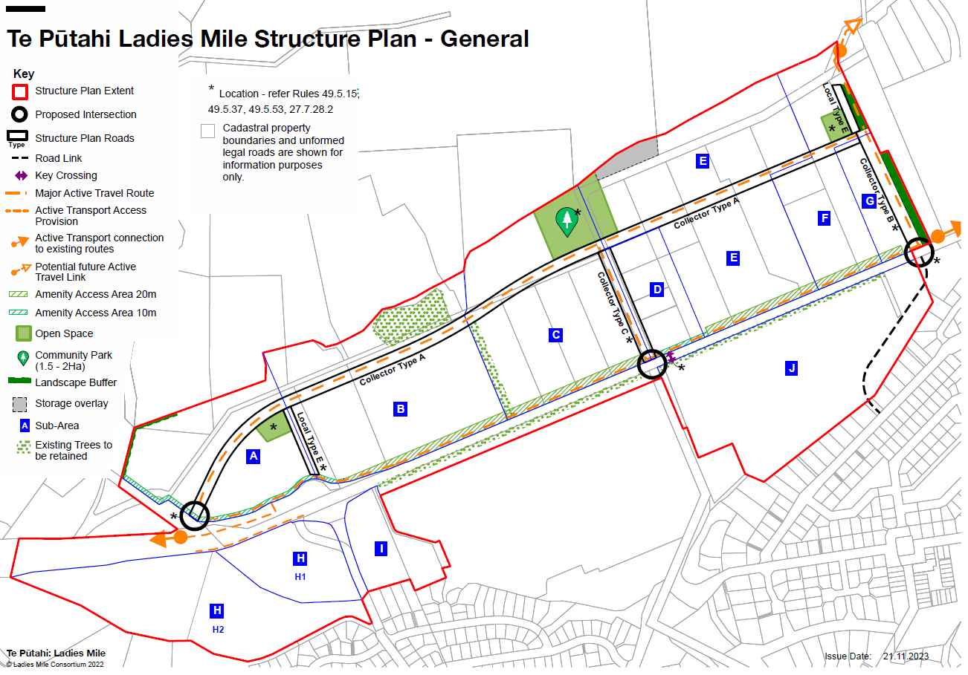
TPLM Variation

Slide 13
TPLM Variation
Key issue 2
Housing – diversity, affordability, efficiency
Objective / policy framework:
Objective 49.2.2 Development achieves a range of residential intensity and diversity of housing choice to promote affordable homes, a self-sustaining community, and efficient use of urban land
Policies that:
Promote a range of residential densities and diversity of housing choice via a range of residential typologies;
Require minimum residential densities in the high and medium density precincts;
Intent is to make most efficient use of the land resource and to maximise affordability.
Methods:
Rule 49.4.4 (RD rule for residential units) – matters of discretion in relation to diversity, range of unit types and choice for market;
Rule 49.5.16 – mechanism that requires density to be within specific ranges for the HDR Precinct and the MDR Precinct (further modifications from the Rebuttal Version).

Slide 14
TPLM Variation
Key issue 3
Non-residential activities
Objective / policy framework:
Objective 49.2.3 Commercial Precinct – compact, convenient and accessible, for meeting needs of local residents
Objective 49.2.4 Glenpanel Precinct – complements the Commercial Precinct
Objective 49.2.5 A range of compatible non-residential activities are provided for
Policies that:
Enable a suitable range of non-residential activities (including retail) – primarily within a town centre and smaller neighbourhood centre;
Enable education activities;
Provide for visitor accommodation in the Commercial and Glenpanel Precincts, and for Residential Visitor Accommodation, in a limited way, in the High Density Residential Precinct;
Provide for community activities, open space and recreation;
Generally not provide for other non-residential activities (industrial, etc).

Slide 15
TPLM Variation
Key issue 3 (continued)
Non-residential activities
Methods:
Zoning Plan – delineating location of precincts;
Activity mix in the Commercial and Glenpanel Precincts;
A 4000m² supermarket within the Commercial Precinct;
Education activities are a permitted activity in the Commercial Precinct; and an RDA within the residential precincts;
Community Activities are a permitted activity in the Commercial and Glenpanel Precincts and a discretionary activity elsewhere;
Within the Open Space Precinct, relevant Chapter 38 (Open Space and Recreation) provisions apply, with specific provisions contained also in Chapter 49 (TPLM);
Residential Visitor Accommodation in the High Density Residential Precinct.

Slide 16
TPLM Variation
Key issue 4
Traffic
Objective / policy framework:
Objective 49.2.6 Development in the Zone minimises the generation of additional vehicle trips along State Highway 6, and reduces, as far as practicable, vehicle trips along State Highway 6 generated by the adjoining residential areas at Ladies Mile.
Policies that:
Along with other provisions, provide for a range of activities within TPLM that will reduce the reasons for private vehicle trips outside of the Eastern Corridor;
Require the integration of the Eastern Corridor communities – current and future;
Provide for efficient and effective public transport through:
  Higher densities
  Road configuration
  Minimising parking
Requiring transport infrastructural works prior to development
Providing for and encouraging active travel;
Requiring Workplace and School Travel Plans.

Slide 17
TPLM Variation
Key issue 4 (continued)
Traffic
Methods:
Zoning and location of activities – commercial nodes, higher and medium density areas, open space and recreation;
Structure Plan requirements – roading, active travel links, cross-sections, north ↔ south integration;
Rules that require transport infrastructure works prior to development (breach status = non-complying);
Rules that require minimum densities of residential development;
Rules that require active travel end of trip facilities;
Rules that require assessment of travel management plans.

Slide 18
TPLM Variation
Key issue 5
Stormwater and ecology
Objective / policy framework:
Objective 27.3.24 Urban development comprising a mix of medium and high density housing, commercial centres, schools, ecological corridors and areas for stormwater management, and open spaces for active and informal recreation, and a network of walkways and cycleways, …
Objective 49.2.8 Development that supports resilience to, and mitigation of, the current and future effects of climate change and contributes to an integrated approach to stormwater management.
Policies that:
Require a range of open spaces and facilities including areas that function as ecological corridors and stormwater management areas, as part of a wider blue-green network;
Require the design of stormwater management systems to avoid direct stormwater discharges to Lake Hayes and avoid the adverse effects of discharges to the Shotover and Kawarau Rivers, the State Highway network, groundwater resources and to neighbouring sites;
Require minimum areas of permeable surfaces for stormwater management.

Slide 19
TPLM Variation
Key issue 5 (continued)
Stormwater and ecology
Methods:
Rule 27.7.28.1 – subdivision within the TPLM Zone – matters of discretion including:
  How the stormwater management proposed for the subdivision will be managed as part of an integrated stormwater management system for the TPLM Zone north of SH6;
  How a fully integrated stormwater management solution for Slope Hill is to be coordinated to ensure no adverse effects on downstream properties;
An Information Requirement, at subdivision consent stage, for a statement and supporting plans to demonstrate how the stormwater management proposed will be managed as part of an integrated stormwater management system for the TPLM Zone north of SH6;
Assessment matters for subdivision design, and the integrated stormwater management system, and the inclusion of the “Guiding Principles” for stormwater management in the TPLM Zone;
Assessment of how the proposal protects, maintains or enhances indigenous biodiversity.

Slide 20
TPLM Variation
Key issue 6
Urban design and the built environment
Objective / policy framework:
Objective 49.2.7 An attractive built environment that positively responds to streets and open spaces, provides a high level of residential and neighbourhood amenity, achieves high quality urban design and ecological outcomes and incorporates indigenous biodiversity in design.
Bespoke objective in Chapter 27 (subdivision), along with suites of policies for subdivision and land use regarding subdivision design, site design, integration with public spaces, CPTED principles, Manawhenua values, accessibility, lighting, building design, building bulk and location, landscaping, and residential amenity values.
Methods:
Subdivision – Chapter 27 rules:
  TPLM Zone-specific rules (RDA consent required for subdivision in the Zone);
  mandatory information requirements;
  a range of bespoke matters of discretion and assessment matters (that complement the general matters in Chapter 27 for urban subdivision) for subdivision design, infrastructure, future usability (density, diversity), stormwater management;
Land use – Chapter 49 rules:
  RDA consent required for all buildings of 2+ residential units and non-residential buildings
  Matters of discretion and assessment matters for design, spatial layout, signage, lighting, relationship to the street and public spaces, landscaping; parking access and layout; housing diversity;

Slide 21
TPLM Variation
Key issue 7
Climate change and sustainable housing
Objective / policy framework:
Objective 49.2.8 Development that supports resilience to, and mitigation of, the current and future effects of climate change and contributes to an integrated approach to stormwater management.
Policies that:
Encourage site and building design that promotes sustainability including energy conservation, waste reduction and emissions reduction;
Require minimum permeable surface for stormwater management and amenity;
Incentivises greater height where development design achieves improved design for sustainability.
Methods:
Standards for permeable surfaces;
Matters of discretion and assessment matters that promote and encourage sustainability in design – refer 49.7.1(f) – sustainability and resilience.

Slide 22
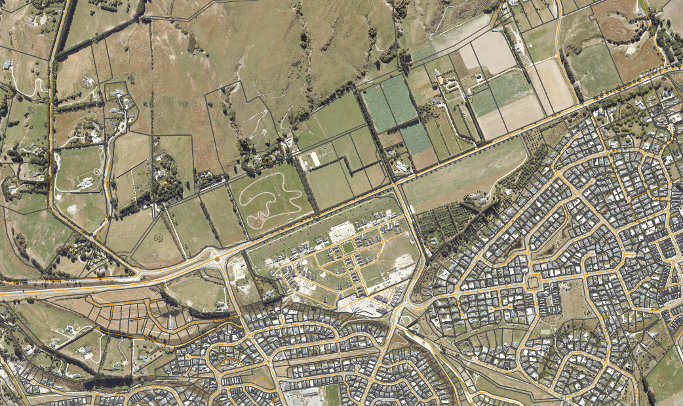
TPLM Variation
Other matters
TPLM Zone eastern end (Finlin / Dobb land) – location of eastern roundabout, eastern boundary treatment north of SH6;
TPLM Zone western end (Hutchinson land);
Queenstown Country Club;
Koko Ridge / Corona Trust;
Doolyttle;
Slope Hill ONF / UGB

Slide 23
TPLM Variation
A comment on ‘regulation’
A continuum:
No regulation
Market leads
Heavy regulation
Market must follow

